Slide 1
Code Reviews
Slides adapted from MIT and Prof. Pred Devanbu

Slide 2
Code Reviews
Code review is careful, systematic study of source code by people who are not the original author of the code.
It’s analogous to proofreading a term paper.
Two purposes:
Improving the code.
Finding bugs, anticipating possible bugs, checking the clarity of the code, and checking for consistency with the project’s style standards.
Improving the programmer.
Code review is an important way that programmers learn and teach each other, about new language features, changes in the design of the project or its coding standards, and new techniques.
Notes:
A required sign-off from another team member before a developer is permitted to check in changes or new code.
> 1 person has seen every piece of code
Prospect of someone reviewing your code raises quality threshold.
Forces code authors to articulate their decisions
Hands-on learning experience for rookies without hurting code quality
Pairing them up with experienced developers
Team members involved in different parts of the system
Reduces redundancy, enhances overall understanding
Author and reviewer both accountable for committing code

Slide 3
Mechanics
who: Original developer and reviewer, sometimes together in person, sometimes offline.
what: Reviewer gives suggestions for improvement on a logical and/or structural level, to conform to previously agreed upon set of quality standards.
Feedback leads to refactoring, followed by a 2nd code review.
Eventually reviewer approves code.
when: When code author has finished a coherent system change that is otherwise ready for checkin
change shouldn't be too large or too small
before committing the code to the repository or incorporating it into the new build

Slide 4
Actual Studies
Average defect detection rates
Unit testing: 25%
Function testing: 35%
Integration testing:45%
Design and code inspections: 55% and 60%.
11 programs developed by the same group of people
First 5 without reviews: average 4.5 errors per 100 lines of code
Next 6 with reviews: average 0.82 errors per 100 lines of code
Errors reduced by > 80 percent.
IBM's Orbit project: 500,000 lines, 11 levels of inspections. Delivered early and 1 % of the errors that would normally be expected.
After AT&T introduced reviews, study with > 200 people reported a +14% productivity, -90% defects.
(From Steve McConnell’s Code Complete)

Slide 5
Code Reviews in Industry
Code reviews are a very common industry practice.
Made easier by advanced tools that:
integrate with configuration management systems
highlight changes (i.e., diff function)
allow traversing back into history
E.g.: Eclipse, IntelliJ, Git/SVN tools
Notes:
In open source projects, particularly, much conversation happens in the context of code reviews. Also widely adopted in industry.

Slide 6
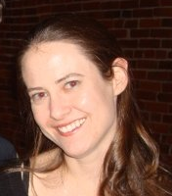
Code Reviews at Google
"All code that gets submitted needs to be reviewed by at least one other person, and either the code writer or the reviewer needs to have readability in that language."
…obviously, we spend a good chunk of our time reviewing code."
Amanda Camp, Software Engineer, Google

Slide 7

Code Reviews at Yelp
"At Yelp ….An engineer works on a branch and commits the code to their own branch. The reviewer then goes through the diff, adds inline comments on review board and sends them back."
"The reviews are meant to be a dialogue, so typically comment threads result from the feedback. Once the reviewer's questions and concerns are all addressed they'll click "Ship It!" and the author will merge it with the main branch for deployment the same day.”
Alan Fineberg, Software Engineer, Yelp

Slide 8
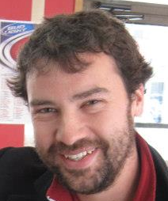
Code Reviews at Facebook
"At Facebook,….. Once an engineer has prepared a change, she submits it to this tool, which will notify the person or people she has asked to review the change, along with others that may be interested in the change -- such as people who have worked on a function that got changed. At this point, the reviewers can make comments, ask questions, request changes, or accept the changes. If changes are requested, the submitter must submit a new version of the change to be reviewed. All versions submitted are retained, so reviewers can compare the change to the original, or just changes from the last version they reviewed. Once a change has been submitted, the engineer can merge her change into the main source tree for deployment to the site during the next weekly push, or earlier if the change warrants quicker release."
Ryan McElroy, Software Engineer, Facebook

Slide 9

Code Reviews at Uber
“…my boss asked me to spend 80-90% of my time on code reviews and doc reviews, instead of feeling pressured to write my own code. He thinks that I can contribute much more to the whole project in reviewing than coding.”
“I was reading a diff earlier today. Part of that diff checks whether the access token on the integration test server is expired and, if so, requests a new token from the authentication server. However, I realized that if the authentication server is down at the time when the access token is expired, all integration tests will fail. My suggestion was to renew the access token 8 hours before it expires. This allows us an 8-hour safe buffer to run integration tests, even in case that the authentication server is down. Such issue may be revealed through code review, but never unit testing.”
Zhongpeng Lin, Software Engineer, Uber

Slide 10
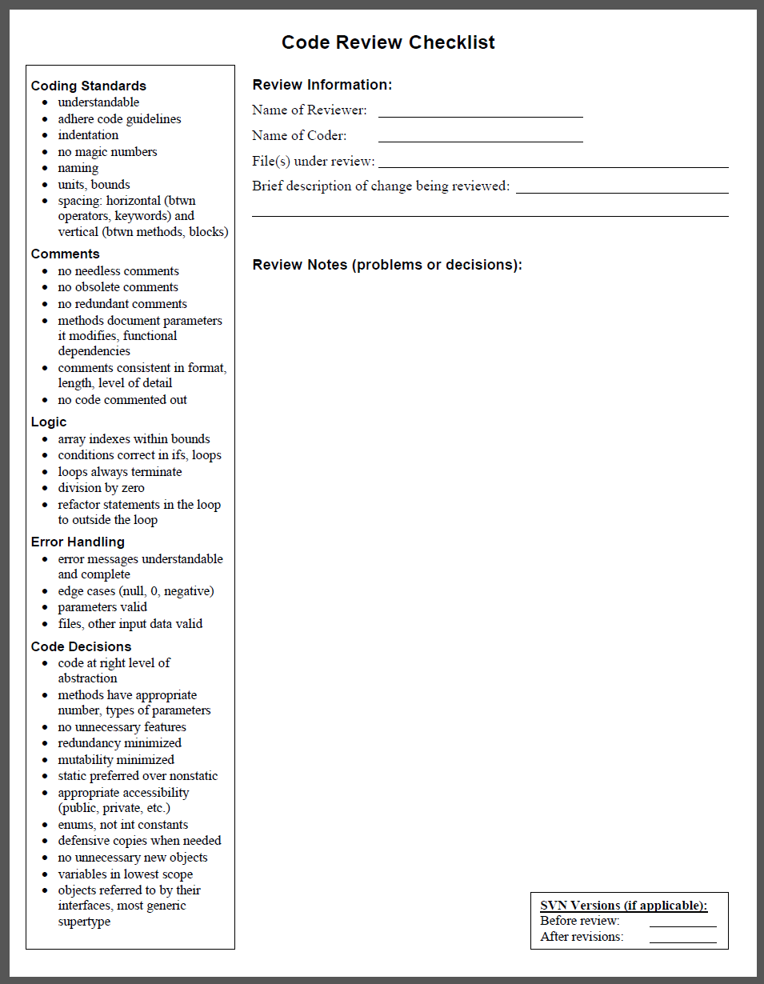
Code Review Checklist
Most companies and large projects have coding style standards
Useful to divide checks into categories, such as:
Coding Style Standards
Comments
Logic
Error Handling
Coding Decisions
Some tools (e.g. GitHub) allow you to comment directly on the code in the commit.

Slide 11
Code Review Starter List
General principles of good code:
Don’t repeat yourself (DRY)
Comments Where Needed
Fail Fast
Avoid Magic Numbers
One purpose for each variable
Use good names
No global variables
Return results, don’t print them
Use whitespace for readability
Source: https://web.mit.edu/6.005/www/fa15/classes/04-code-review/#remember_the_exercises

Slide 12
Smelly Example #1
Try it at: https://github.com/yy2111/CodeReview

Slide 13
Don’t Repeat Yourself (DRY)
Duplicate code is bad
because you modify one instance of duplicated code but not the others; not all versions fixed
Avoid duplication like you’d avoid crossing the street without looking.
Copy-and-paste is an enormously tempting programming tool, and you should feel a frisson of danger run down your spine every time you use it.
The longer the block you’re copying, the riskier it is.
DRY has become a programmer’s mantra.

Slide 14
Exercise
The dayOfYear() example is full of identical code. How would you DRY it out?
Some of the repetition in dayOfYear() is repeated values. How many times is the number of days in April written in dayOfYear()?
One reason why repeated code is bad is because a problem in the repeated code has to be fixed in many places, not just one. Suppose our calendar changed so that February really has 30 days instead of 28. How many numbers in this code have to be changed?
Another kind of repetition in this code is dayOfMonth+=. Assume you have an array int[] monthLengths = new int[] { 31, 28, 31, 30, ..., 31}. Which of the following code skeletons could be used to DRY the code out enough so that dayOfMonth+= appears only once?
for (int m = 1; m <= month; ++m) { ... }
switch (month) { case 1: ...; break; case 2: ...; break; ... }
while (m < month) { ...; m += 1; }
if (month == 1) { ... } else { ... dayOfYear(month-1, dayOfMonth, year) ... }
Notes:
8; 10; for, while, or recursive call

Slide 15
Comments Where Needed
Good software developers write comments in their code, and do it judiciously.
Document important assumptions, e.g. in JAVADocs.
Make the code easier to understand, safer from bugs, and ready for change.
Specifies the provenance or source of a piece of code that was copied or adapted from elsewhere.
However, some comments are bad and unnecessary, e.g.:

Slide 16
Exercise
Which comments are useful additions to the code? Consider each comment independently, as if the other comments weren’t there.
Try it at: https://github.com/yy2111/CodeReview
Notes:
C1 is definitely a good addition because it clarifies what the month parameter means. In general, you should have a specification comment like this before every method. This specification isn’t complete, but it’s a start.
C2 and C3 help clarify what the numbers 2 and 31 signify. The comments help here, but we’ll see shortly that a better way to explain these lines is not with comments but with descriptive names, like month == FEBRUARY and dayOfMonth += MONTH_LENGTH[JANUARY].
C4 and C5 contribute nothing that a capable reader of Java wouldn’t already know.

Slide 17
Fail Fast
Failing fast means that code should reveal its bugs as early as possible. The earlier a problem is observed (the closer to its cause), the easier it is to find and fix.
Static type checking fails faster than dynamic checking, and dynamic checking fails faster than producing a wrong answer that may corrupt subsequent computation.
The dayOfYear function doesn’t fail fast — if you pass it the arguments in the wrong order, it will quietly return the wrong answer. In fact, the way dayOfYear is designed, it’s highly likely that a non-American will pass the arguments in the wrong order! It needs more checking — either static checking or dynamic checking.

Slide 18
Exercise
Suppose the date is February 9, 2019. The correct dayOfYear() result for this date is 40, since it’s the fortieth day of the year.
Which of the following are plausible ways that a programmer might (mistakenly) call dayOfYear()? And for each one, does it lead to a static error, dynamic error, or wrong answer?
dayOfYear(2, 9, 2019)
dayOfYear(1, 9, 2019)
dayOfYear(9, 2, 2019)
dayOfYear("February", 9, 2019)
dayOfYear(2019, 2, 9)
dayOfYear(2, 2019, 9)
Notes:
dayOfYear(2, 9, 2019) not a mistake – right answer
dayOfYear(1, 9, 2019) plausible mistake – wrong answer
dayOfYear(9, 2, 2019) plausible mistake – wrong answer
dayOfYear("February", 9, 2019) plausible mistake – static error; This is plausible if the programmer is assuming the month is passed by a string name (in English). Static type checking forbids passing a String to an int argument, however, so the mistake is caught fast, before the program even starts.
dayOfYear(2019, 2, 9) plausible mistake – wrong answer
dayOfYear(2, 2019, 9) implausible mistake; This is implausible because no convention for writing dates puts the year in the middle. It’s unlikely to happen by accident.

Slide 19
Avoid Magic Numbers
Replace magic constant number with symbolic constant
There are really only two constants that computer scientists recognize as valid in and of themselves: 0, 1
dayOfYear() is full of magic numbers
The months 2, …, 12 would be far more readable as FEBRUARY, …, DECEMBER.
The days-of-months 30, 31, 28 would be more readable (and eliminate duplicate code) if they were in a data structure like an array, list, or map, e.g. MONTH_LENGTH[month].
The mysterious numbers 59 and 90 are particularly pernicious examples of magic numbers.
uncommented and undocumented,
the result of a computation done by hand by the programmer. (Don’t hardcode constants that you’ve computed by hand)

Slide 20
Smelly Example #2
Consider this code:
for (int i = 0; i < 5; ++i) {
turtle.forward(36);
turtle.turn(72);
}
Which is a better rewrite by replacing numbers with names in order to improve code quality?
a)
b)
c)
Notes:
No improvement.
at least it makes the relationship between the two magic numbers 5 and 72 more obvious. This makes the code safe from a potential bug: a future programmer can’t change the number of iterations of the loop without also changing the turtle’s rotation. This also makes the code more ready for change, because only one number needs to be edited instead of two.
Contrast this version of the code with the original. Can you tell what it does? Notice that comments weren’t needed to make the code clearer, just descriptive names.

Slide 21
Use Good Names
Good method and variable names are long and self-descriptive.
Comments can often be avoided entirely by making the code itself more readable, with better names that describe the methods and variables.
For example, you can rewrite
int tmp = 86400; // tmp is the number of seconds in a day (don't do this!)
as:
int secondsPerDay = 86400;
In general, variable names like tmp, temp, and data are awful
Symptoms of extreme programmer laziness
Better to use a longer, more descriptive name
Follow the lexical naming conventions of the language.

Slide 22
Code Review Tips for Javascript
Basics
as automated as possible
avoid API discussion
be kind, positive in language
Side Effects
Functions should be as pure as possible
I/O functions should have failure cases handled
Readability
Typos should be corrected
Variable and function names should be clear
“This function could be better named as …”
Functions should be short
“This is both emailing clients and deciding which are active. Should be different functions.”
Files should be cohesive, and ideally short
Exported functions should be documented
“This needs documentation. What is this function for? How is it used?”
Complex code should be commented
If you have named things well and the logic is still confusing, then it's time for a comment.
Source: https://github.com/ryanmcdermott/code-review-tips

Slide 23
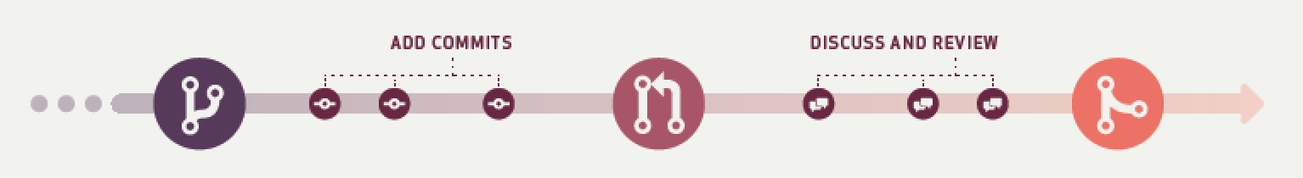
Code Review with GitHub
CREATE A
BRANCH
Create a branch in your
project where you can
safely experiment and
make changes.
OPEN A PULL
REQUEST
Use a pull request to get
feedback on your changes
from people down the hall
or ten time zones away.
MERGE AND
DEPLOY
Merge your changes into
your master branch and
deploy your code.

Slide 24
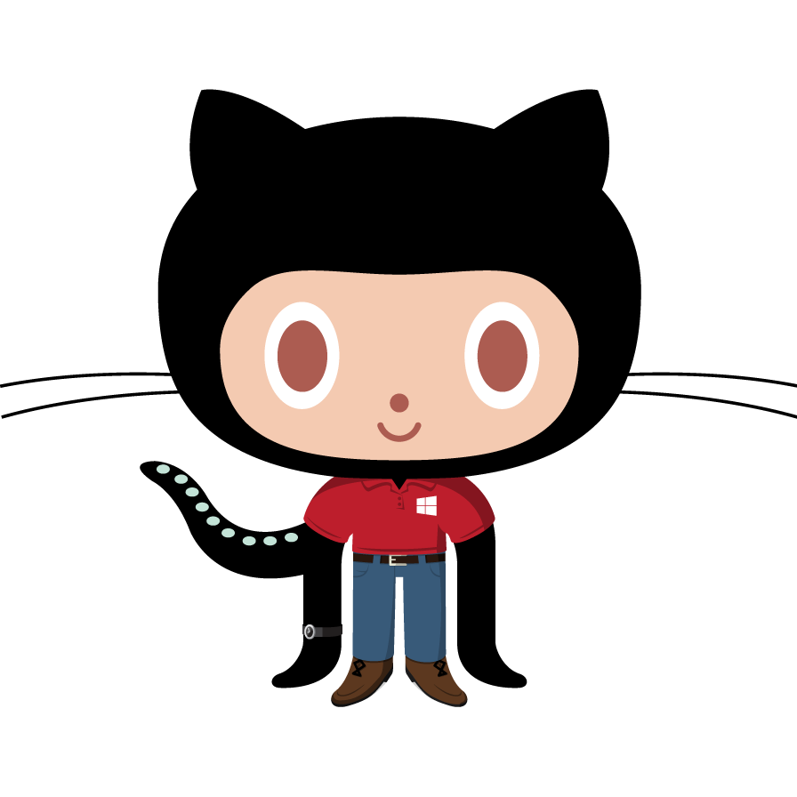



The pull-based model
Octocats from https://octodex.github.com/

Slide 25

The pull-based model
… traditionally
can push
Octocats from https://octodex.github.com/

Slide 26
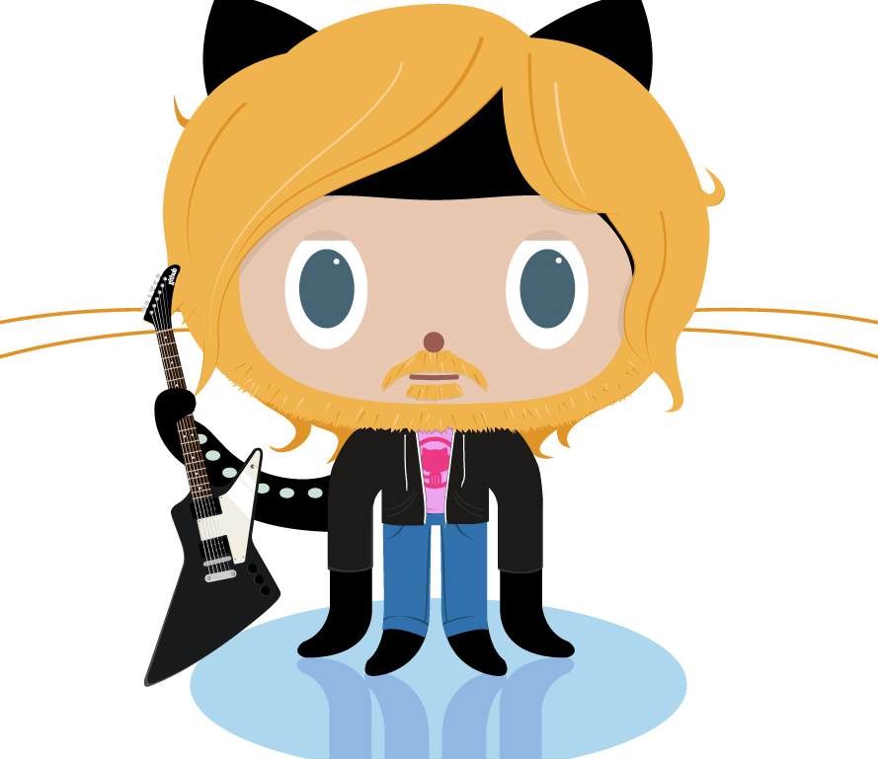

The pull-based model
… traditionally
can’t push
can push
Octocats from https://octodex.github.com/

Slide 27
The pull-based model
submit pull requests
push
Octocats from https://octodex.github.com/

Slide 28
The Pull Request process

Slide 29
The Pull Request process
Create
a branch or fork

Slide 30
The Pull Request process
Add commits

Slide 31
The Pull Request process
Open a
Pull Request

Slide 32
The Pull Request process
Discussion & Code review

Slide 33
The Pull Request process
Pull Request
updates

Slide 34
The Pull Request process
Merge

